Slide 1
Final Project Presentation
Sasank Yadav Daliboyina
Northeastern University: Intermediate Analytics
Professor Amin Karimpour

Slide 2
Overview
The dataset from Kaggle titled "IBM HR Analytics Employee Attrition & Performance" provides information on employees and their attrition status.
The Dataset Contains Information contains 1350 records and 35 attributes about the employees in the organization .
The dataset contains information about the attrited employee in the organization . Key traits were found by altering the data, graphs, tables, and other visual representations made to use R studio in understanding the data .
The dataset helps identify key factors strongly associated with attrition, aiding in understanding why employees leave. By employing logistic regression and random forest models, we can predict attrition with considerable accuracy.
Both models can effectively capture the complex relationships between features and attrition, providing valuable insights for organizations to make informed decisions and implement retention strategies.

Slide 3
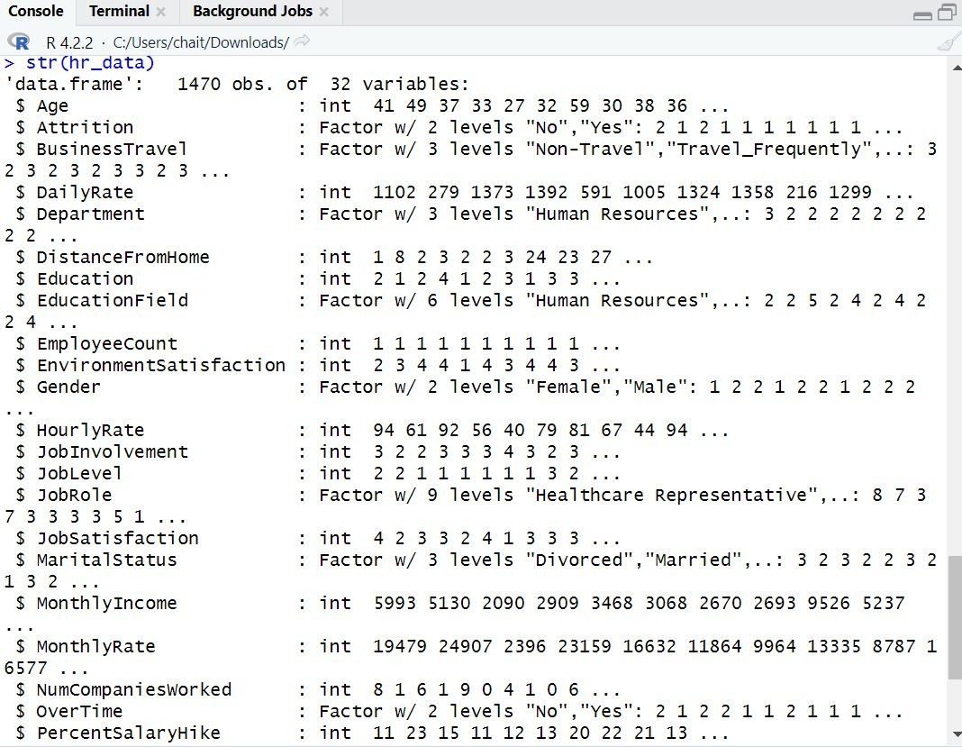
Summary About the Data
The given dataset contains 1,470 observations (rows) and 35 variables (columns).The dataset has been examined in order to extract various statistical data. By using the Str command, you may obtain statistical details on the qualities available in the data, such as their length Class and mode.Many sorts of data types are included in the dataset chosen for analysis. Its data types are character, int, and num.

Slide 4
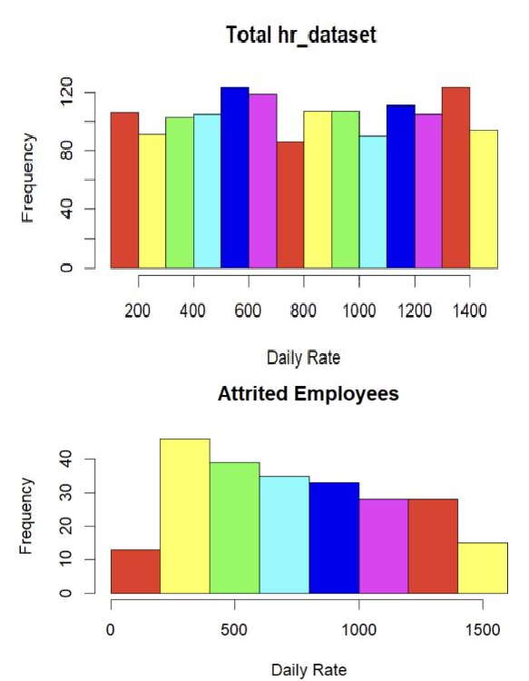
Histogram for the Daily rate
Daily rates of employees in the organization are evenly distributed across all levels.
Attrited employees with daily rates between approximately 250 and 1000 are more prone to leaving the company.
Middle-range employees show a higher tendency to resign compared to both junior and senior staff members.

Slide 5
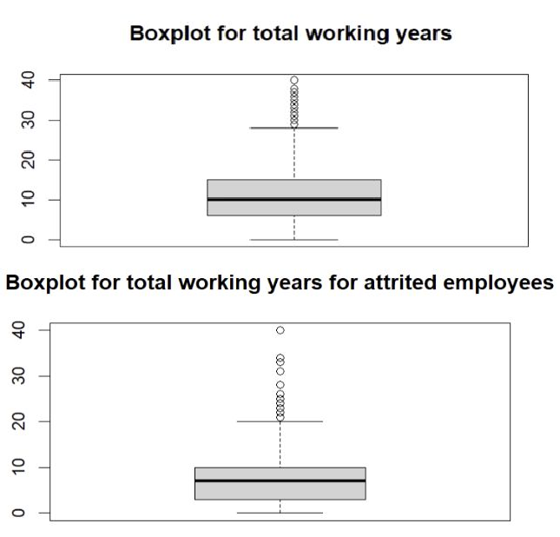
Boxplot For Total Working Years
Boxplot for the total Working Years of whole organization and attrited employee has been plotted .
Attrited employees have a median of 7 years of experience.
The overall organization has a median experience of around 10 years.

Slide 6
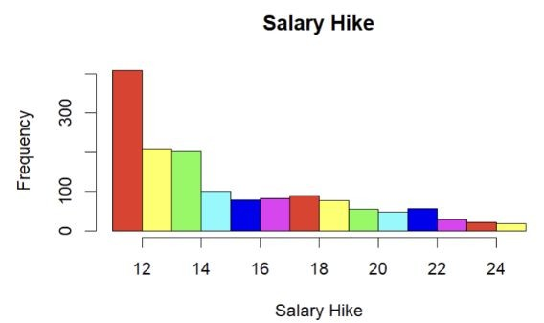
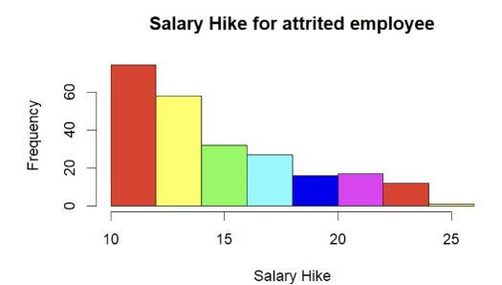
Histogram of the Percentage Salary Hikes
The histogram illustrate the salary hike distribution of employees in the organization and the attrition rate.
The analysis of the graph indicates that employees who receive a salary hike between 10 to 15% are more prone to leaving the organization.
The plotted data suggests a correlation between salary increases within this specific range and employee attrition.
Further examination of the graph can provide insights into strategies to retain employees and mitigate attrition within the organization.

Slide 7
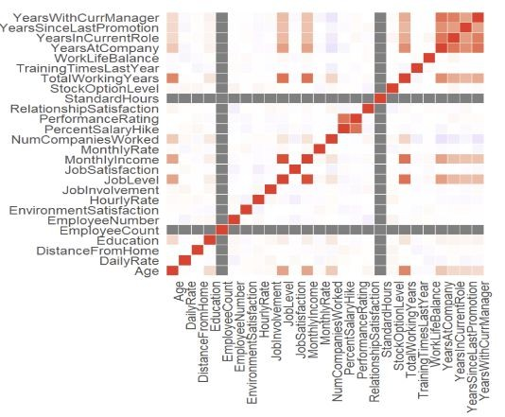
Correlation Plot
A correlation diagram has been constructed to display the interrelationships among various variables in a dataset.
The diagram enables the identification of the correlation magnitude and direction between the variables.
The strength of the correlation is depicted on the right axis of the diagram.
Positive correlations are represented by shades of blue and red, while negative correlations are depicted by shades of red.

Slide 8
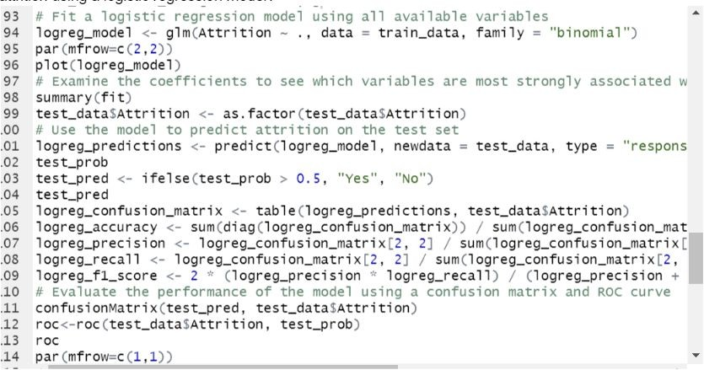
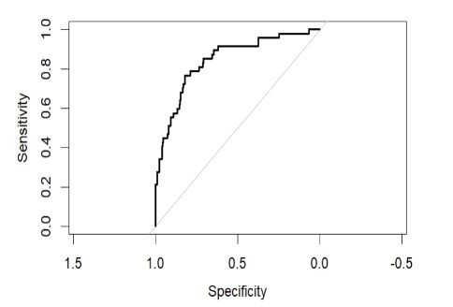
Logistic regression model for Employee Attrition
The aim is to use multivariable logistic regression to analyze the connection between different employee characteristics and the likelihood of attrition.
A logistic regression model will be built using all the relevant variables to predict employee attrition.
The model's performance will be evaluated on a separate test set using a confusion matrix and ROC curve.
The model's AUC value is 0.8432, indicating its performance in distinguishing between positive and negative cases.

Slide 9
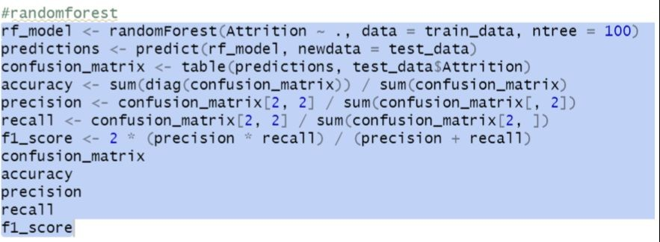
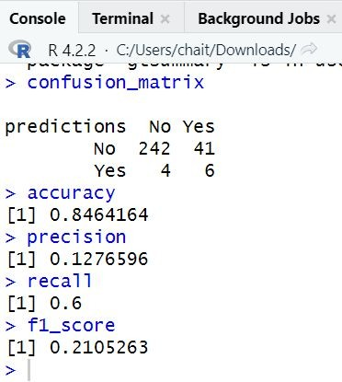
Random Forest algorithm For Predicting Employee Attrition
Random forest algorithm employed for employee attrition prediction model utilizing multiple variables.
Model construction aids in understanding the relationship between various factors and attrition.
Training the model with relevant variables allows for performance assessment on a separate test set using techniques like a confusion matrix.
The model achieves an accuracy of 84.6% while exhibiting precision of 12.8%, recall of 60%, and an F1 score of 21.1%.

Slide 10
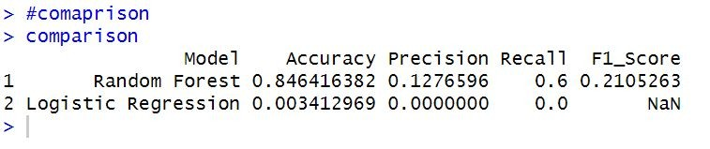
Comparing the random forest and logistic regression model
Relying on a single metric to evaluate model performance is not recommended.
Model 1 (Random Forest) has shown better performance than Model 2 (Logistic Regression) in accuracy, precision, recall, and F1 score.
The low values for accuracy, precision, and recall in Model 2 suggest potential weaknesses in its performance.
The NaN value for F1 score is unusual and should be investigated further for calculation or data issues.

Slide 11
Conclusion
This HR analytics project focuses on data analysis and visualization using a Kaggle dataset. The analysis includes descriptive statistics, subset creation, and visualization techniques.
Findings reveal that employees with daily rates between 250 and 1000 are more likely to leave compared to junior and senior employees. Salary hikes of 10-15% also contribute to higher attrition rates.
The median total working years for attrited employees is 7, while the organization's median is approximately 10.
Two predictive models, logistic regression and random forest, are developed. The random forest model outperforms logistic regression in accuracy, precision, recall, and F1 score, achieving an AUC value of 0.8432.

Slide 12
THANK YOU

